Slide 1
Warninternational.com

Slide 2
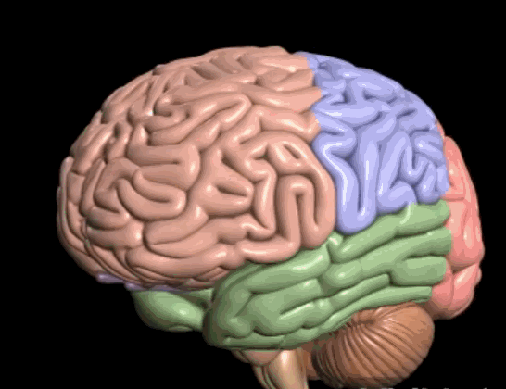

Slide 3
Catastrophising!

Slide 4
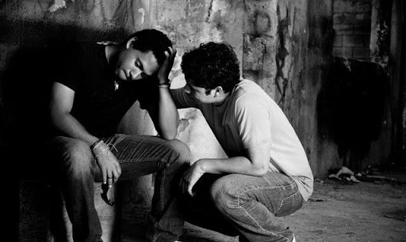
Who Do You Care About?

Slide 5
Uncertainty!

Slide 6
Run to the FIRE
Notes:
4 emotions are negative = 80% of memory is of negative events

Slide 7
Debriefing Events

Slide 8
CHANGE & DISRUPTION

Slide 9
Common Disruption Activities
Multitasking – doing too many things
Procrastination – plays on our mind
Paralysis – stuck in our thinking
Heightened emotions – overthinking & worry

Slide 10
ADAPTING TO OUR BUSY WORLD

Slide 11
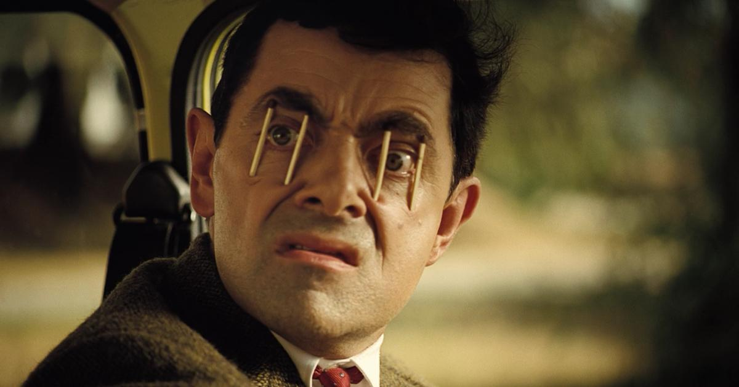
Sleep

Slide 12
Deeper Fixes

Slide 13
Breathe

Slide 14
You’ve Got This!
www.warninternational.com

