Slide 1
Post-Pandemic Pressures: A legally-slanted survival guide NZIBS Training Day
James Lewis
18 March 2023

Slide 2
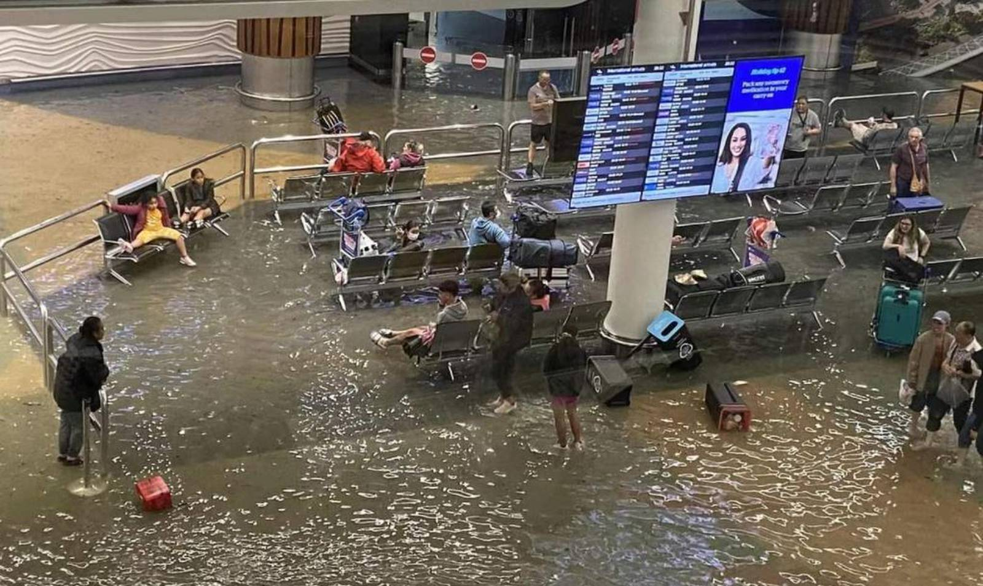
Background
NEW ZEALAND
CLIMATE CHANGE
NZS3910
Strong Demand
Rising Interest Rates
Skilled Labour Shortages
Supply Chain Issues
Delays
Lockdowns
COVID

Slide 3
Background
NZS3910
Strong Demand
PRESSURE
Rising Interest Rates
Skilled Labour Shortages
Supply Chain Issues
PRESSURE
Delays
Lockdowns

Slide 4
Agenda – Dealing with Pressure Points
One
Engineer to the Contract
Two
Three
Dealing with Payment Claims
Four
NZS3910 Update
Dealing with Delays

Slide 5
ENGINEER TO THE CONTRACT

Slide 6
Responsibilities of Engineer to the Contract
Design / Consultancy Services
Insurer
Principal
Insurer’s Lawyers
P I Insurance
Consultancy Agreement
EtC
Construction Contract
Ethical
Obligations
Contractor

Slide 7
How does it work? The Importance of Context…
Ultimately a matter of Contract Interpretation
Depends on the terms of the Contract
However, as with all Contract Interpretation, the relevant case law is important…

Slide 8
How it Works: The Engineer’s Dual Role (6.2.1)
Agent of the Principal:
the Principal’s expert adviser;
the Principal’s representative; and
the Principal’s agent.
Independent Valuer and Certifier:
independent, fair and impartial;
decision-maker under the Contract;
value work and issue certificates.

Slide 9
How it Works: The Duties and Powers of the Engineer
Valuing Variations (9.3)
Clarifying ambiguities in contract documents (2.7)
Determining unforeseen physical conditions (9.5)
Extensions of Time (10.3)
Advance notification (5.21)
Certifying Practical Completion (10.4)
Principal’s Representative
Suspension of work (6.7)
Independent Certifier
Reduction of liquidated damages (10.5.2)
Updates to Comprehensive Programme (5.10)
Assessment of payment claims and issuing PPS (12.2, 14.4 & 12.5)
Instructions to the Contractor (5.1.2)
Final Completion Certificate (11.3)

Slide 10
The Common Law: The Engineer’s Professional Duties
“It has often been said, I think rightly, that the architect has two different types of functions to perform. In many matters he is bound to act on his client’s instructions whether he agrees with them or not, but in many other matters requiring professional skill he must form and act on his own opinion.”
(Sutcliffe v Thackrah [1974] AC at 727).

Slide 11
The Common Law: The Engineer’s Professional Duties
“It has often been said, I think rightly, that the architect has two different types of functions to perform. In many matters he is bound to act on his client’s instructions whether he agrees with them or not, but in many other matters requiring professional skill he must form and act on his own opinion.”
(Sutcliffe v Thackrah [1974] AC at 727).
Agent of the Principal.

Slide 12
The Common Law: The Engineer’s Professional Duties
“It has often been said, I think rightly, that the architect has two different types of functions to perform. In many matters he is bound to act on his client’s instructions whether he agrees with them or not, but in many other matters requiring professional skill he must form and act on his own opinion.”
(Sutcliffe v Thackrah [1974] AC at 727).
Agent of the Principal.
Independent decision maker.

Slide 13
The Common Law: The Engineer’s Professional Duties
“The building owner and the contractor make their contract on the understanding that in all such matters the architect will act in a fair and unbiased manner, and it must therefore be implicit in the owner’s contract with the architect that he shall not only exercise due care and skill but also reach such decisions fairly holding the balance between his client and the contractor”.
(Sutcliffe v Thackrah [1974] AC at 727).
In performing its functions, an Engineer must act fairly and impartially between employer and contractor.

Slide 14
The Common Law: Duty of Independence and Impartiality
Contract Administrators cannot be truly independent.
This is why the Engineer must exercise impartiality in exercising their judgment and discretion.
Impartiality is to be tested by objective conduct.
Impartiality is the absence of undue influence.
This does not extend as far as observing the principles of natural justice.
e.g. the Engineer doesn’t need to afford hearing,
but if they do, they must do so for both.

Slide 15
The Common Law: Duty of Fairness
“… he [that being the contract administrator] is not employed by the owner to be unfair to the contractor”
(as per Lord Morris in Sutcliffe v Thackrah [1974] AC)
Fairness is a “broad” and even “elastic” concept.
Usually used to describe and Engineer in the role of a valuer of certifier (as it is in Canterbury Pipes).
The question is not one of conscious unfairness.
This question will be taken in the wider context.

Slide 16
The Common Law: Drawing the Threads Together
Four key propositions emerge:
Precise duties are determined by the contract.
Generally, the Engineer is not independent.
The Engineer is required to act in a manner that is impartial, fair and honest.
The Engineer’s legal duty cannot be diluted.
(Costain v Bechtel [2005] EWHC 1018; Scheldebouw BV v St James Homes (Grosvenor Dock) Ltd [2006] EWHC 89)

Slide 17
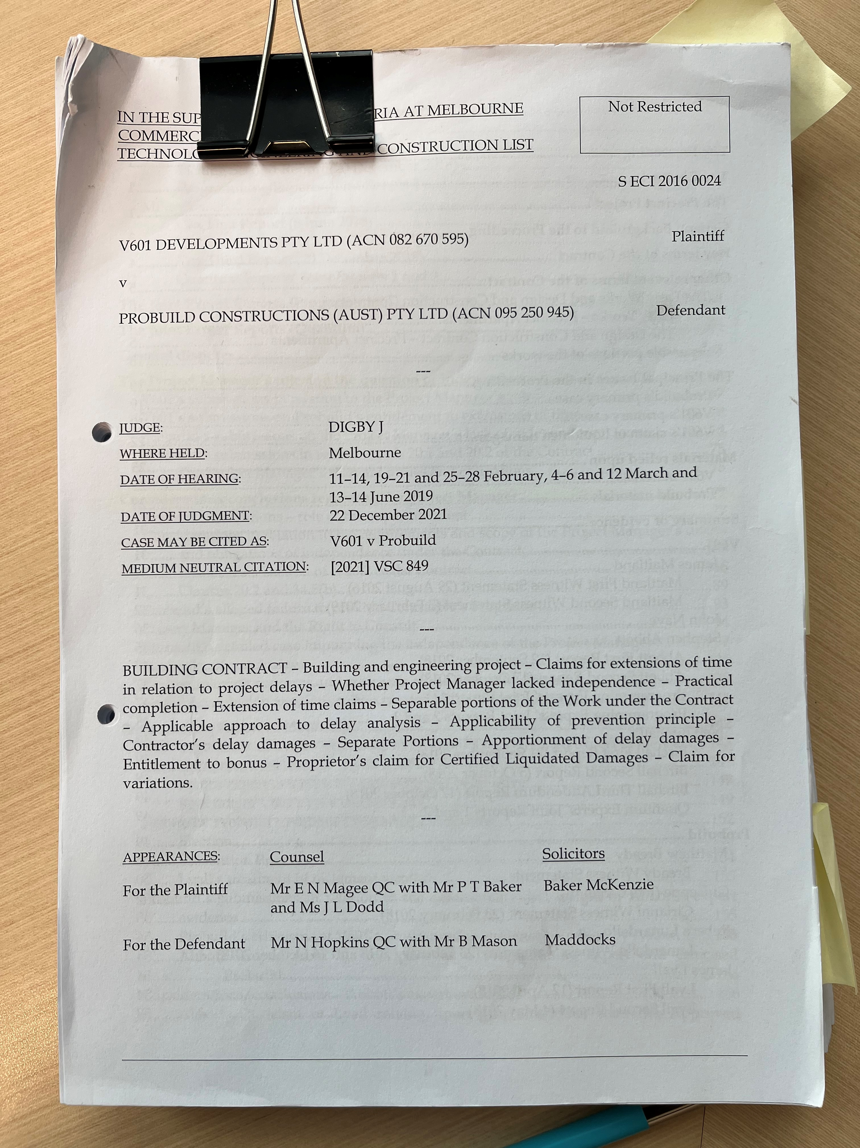
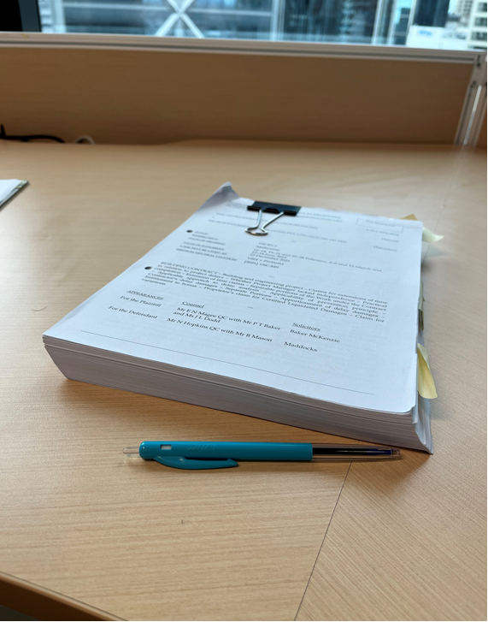
Consequences
Principal refuses to remove Contract Administrator
Certificates set aside
Breach of warranty
Interest
Time at large?
Spiraling project costs
Increased Correspondence
Claims (including thickening / disruption)
Dispute resolution
Damages

Slide 18
DEALING WITH DELAYS

Slide 19
NZS 3910:2013 / 3916:2013
COVID
SUPPLY CHAIN
Ground | EOT? | Cost? | EOT? | Cost?
Net effect of a Variation | Maybe | ✓ | Maybe | ✓
Change in law | Maybe | ✓ | Doubtful | ✗
Not reasonably foreseeable | Unlikely | ✗ | Unlikely | ✗
Default by the Principal | Unlikely | ✗ | Yes | ✓

Slide 20
Concurrent Delay - Competing Considerations
Obverse Problem: Overlapping critical delay caused independently by a culpable event and a non-culpable event.
Culpable Delay = LDs
Non-Culpable Delay = EOT

Slide 21
Different Solutions
Dominant Cause approach
Contractor only entitled to EOT where the Principal’s delay is the “dominant cause”.
Apportionment approach
Responsibility for concurrent delay is apportioned based on what is fair and reasonable.
Malmaison approach
Contractor is entitled to EOT for the full period of concurrent delay, but no time-related costs.

Slide 22
Correct Approach?
Possibly Malmaison (ie full EOT but no time-related costs).
However, …
Arguable threshold requirement of “approximately equal causative potency”.
Growing authority that if a culpable event occurs first, any later non-culpable delay is not an effective cause of delay.
Specific wording of 3910 causes complications.

Slide 23
Solution?
Have the parties clearly contracted out?
SCL Protocol on Delay and Disruption:
True concurrent delay is the occurrence of two or more delay events at the same time, one an Employer Risk Event, the other a Contractor Risk Event, and the effects of which are felt at the same time. For a concurrent delay to exist, each of the Employer Risk Event and the Contractor Risk Event must be an effective cause of Delay to Completion (i.e. the delays must both affect the critical path). [Emphasis added]
“True” concurrency is very rare
Disentangle the delay
If “true” concurrency, seek advice

Slide 24
DEALING WITH PAYMENT CLAIMS

Slide 25
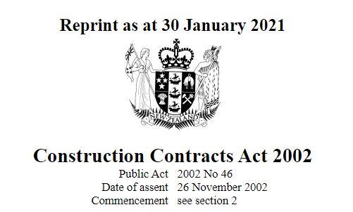

Slide 26
Payment or Debt due?
Payment claim
Payment schedule
No payment schedule
Payment schedule
No payment schedule
No payment schedule
Payment of scheduled amount (no dispute)
Payment of amount of payment claim
No payment or amount paid disputed
No payment or less than amount claimed paid
Debt due?
Debt due

Slide 27
Payment Claims
Due Date
Nicholls Group Projects v Plan Design Build (2022, NZHC)
“Unauthorised” Variations
South Pacific Industrial v Demasol (2021, NZHC); Demasol Limited v South Pacific Industrial Limited (2022, NZCA)
Service by Email
Dempsey Wood Civil v Concrete Structures (2022, NZHC)

Slide 28
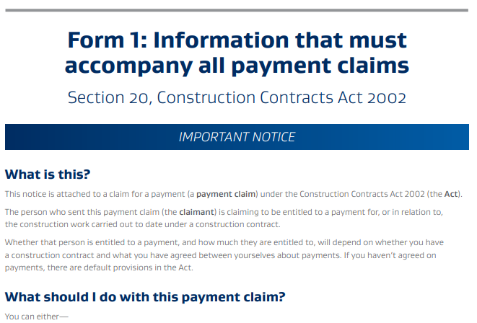

Slide 29
Payment Schedules
3910 Time Periods
Every time period runs from the payment claim
Carried Over Principal’s Deductions
Requires a fresh instruction each month, especially for LDs
Inadequate Reasons – Spotless v Fletcher
Silence, “Not Approved”, “Under Assessment”, Etc

Slide 30
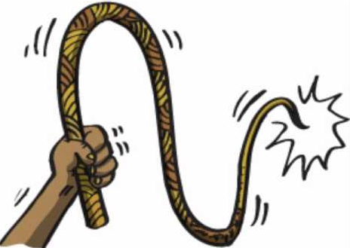
Beware of the Strict Compliance
“Technical Quibbles”
will be overlooked
But any other non-compliance(s)
will invalidate a payment claim or payment schedule

Slide 31
Conditional Schedules?
Without Prejudice Schedules?

Slide 32
NZS3910 UPDATE: WHERE TO FROM HERE?

Slide 33
NZS3910 Update: Timeline
Nov 21–Feb 22
Initiation Phase
Establish /
Approve Committee and Chair
Feb 22-Apr 23
Development Phase
Develops
Development of Draft 3910
May 23-Jul 23
Public Consultation
Aug 2023
Approvals
Committee votes on final draft / preparing NZS3910 for approval
Oct 2023
Publication
Interim Standard
Special Conditions
Interim Update – Replaced with “Recommended Special Conditions” (September 2022), can be incorporated into Special Conditions:
Health and Safety at Work Act 2015
Compliance with Laws (Broadened – clearly cover pandemic)
Advance notification amendments
Indemnity and liability limit
Tweaks to insurance provisions / legislative updates

Slide 34
NZS3910 Update
Role of the Engineer to the Contract – Split into:
(i) Contract Administrator
(ii) Engineer to the Contract
Nomination of Advisers by Principal
Extensions of Time – Changes coming:
Calculating due date for completion (commencement + duration)
Additional wording for war / pandemic (Force Majeure)
Concurrent delay
Balance obligations and remedies re: notices
Expedition / acceleration

Slide 35
NZS3910 Update
Programme – Attention to be given to:
Importance as collaboration and risk management tool
Time bars – fairness, balance, collaboration and relationship to 5.21
Information requirements – increase clarity
Concurrency – how to address these issues
Payments – Changes coming:
Clarify “Principal’s deductions” / GST
Final Account Process
Align with impending CCA retention regime changes
Collaboration – Signaled by amendments to 5.21 advance notification; also highlighted as an area for review

Slide 36
NZS3910 Update
Contractor’s Design Responsibilities – Clarity to be improved
Health and Safety / Environmental
Disputes – Mandatory and optional steps to simplify and clarify the process
Other Topics – Include: Engineer’s powers (some areas requiring Contractor agreement); Subcontracts / subcontractor warranties; Variations; Indemnities; Limitations on liability; Defects liability; Warranties; Definitions; Target cost to be considered
NZS3916 / 3917 (3915) – Will be revised to align with the new 3910 and to (ideally) be released shortly after its publication

Slide 37
James Lewis
Senior Associate
T: 9 375 8735
E: james.lewis@heskethhenry.co.nz

