Slide 1

Matthew Cutler-Welsh
Senior Manager - Residential
NZGBC
INTRODUCING
Notes:
Our presenters today are …

Slide 2
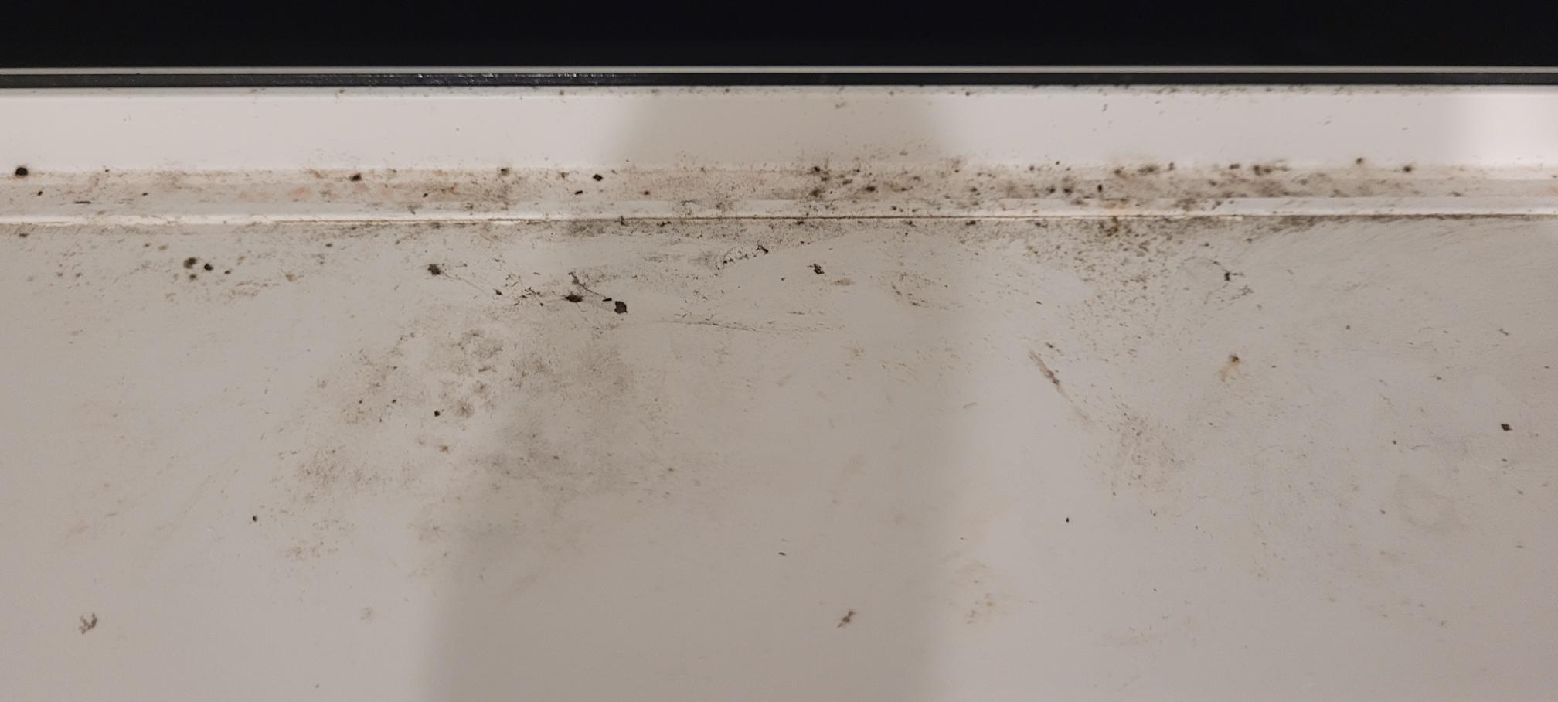
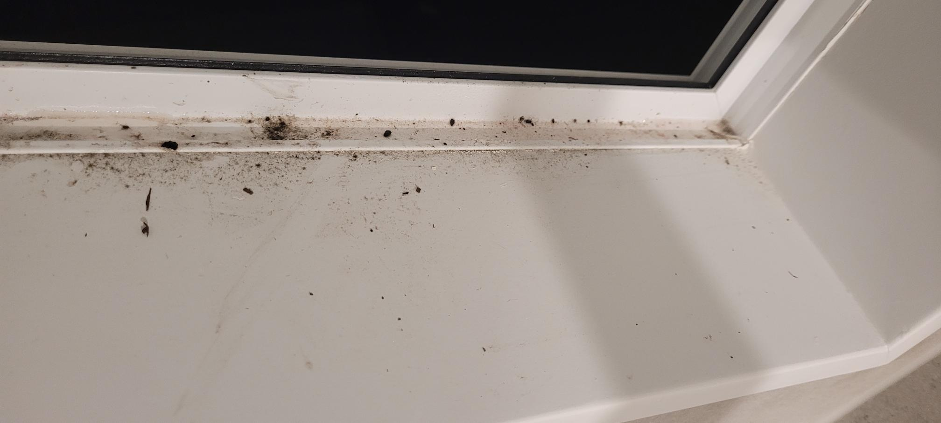
Notes:
Homestar is needed because the Building Code is deficient.
These pictures are from a house built in Auckland, completed in late 2021.
What is causing the mould growth on this window frame?
Thermal bridge (non-thermally broken frames)
Inadequate ventilation
Unhealthy indoor surface temperature

Slide 3
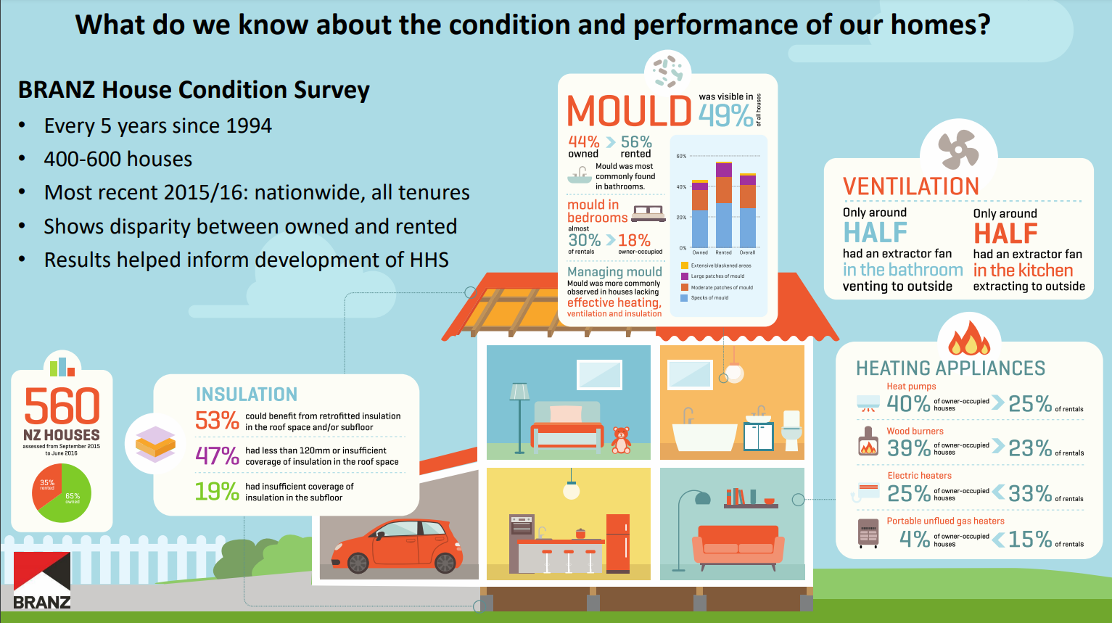

Slide 4
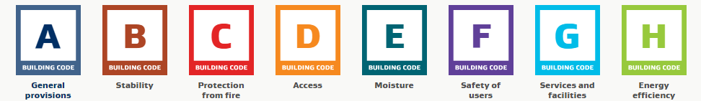
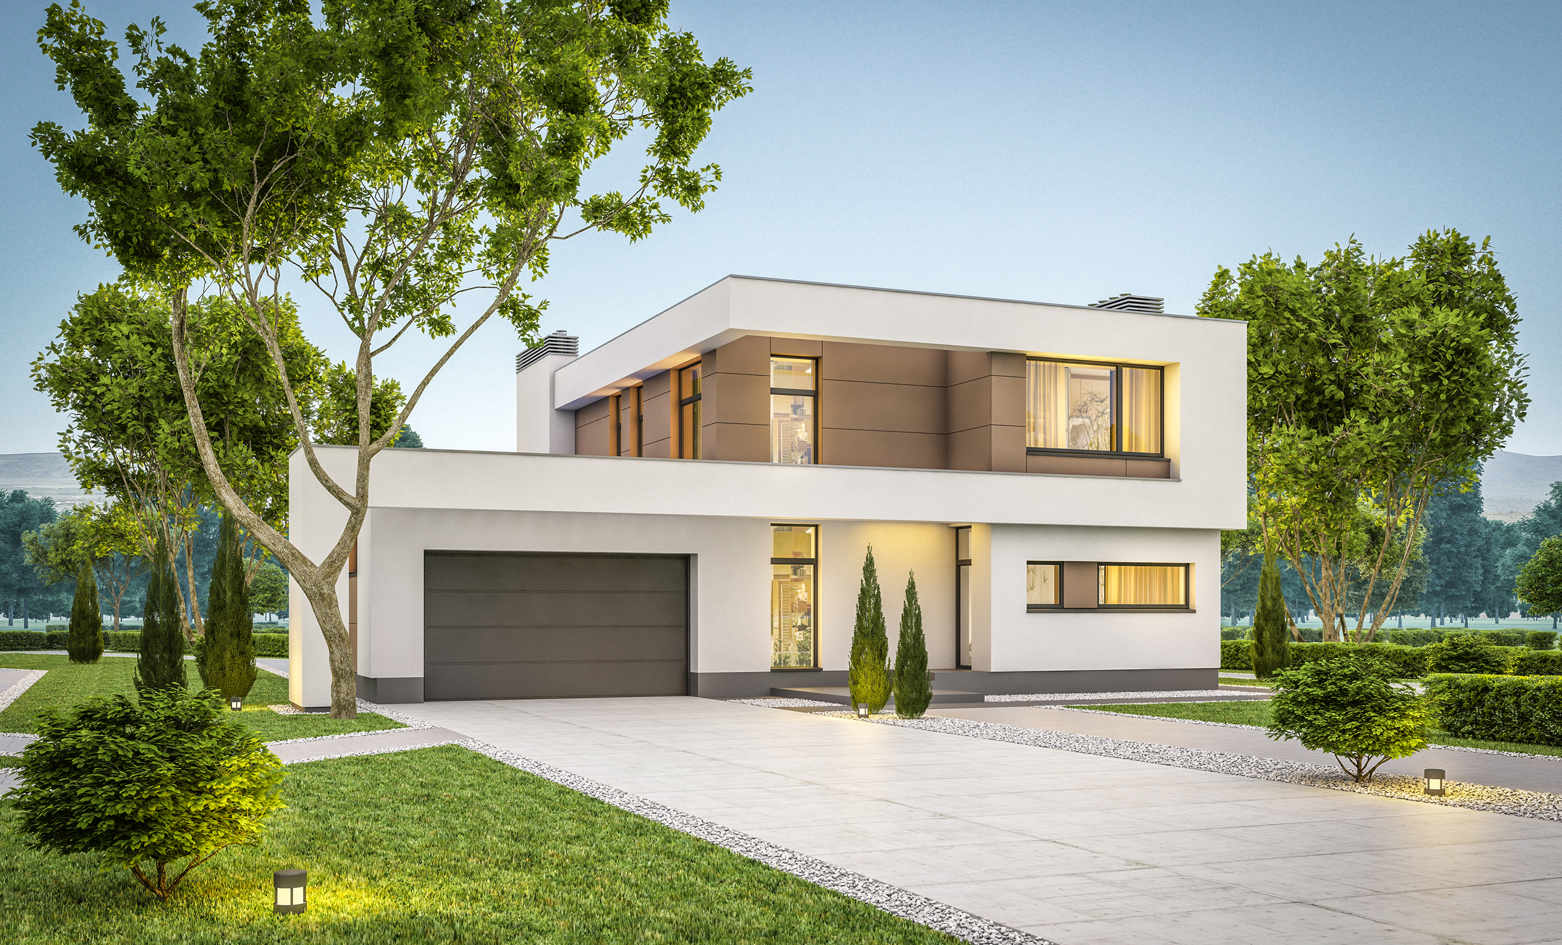
What the building code delivers from November 2023
Insulation levels and window R-value
Fixed heating in living room (HHS but not in building code)
Avoidance of thermal bridges reducing condensation

Slide 5
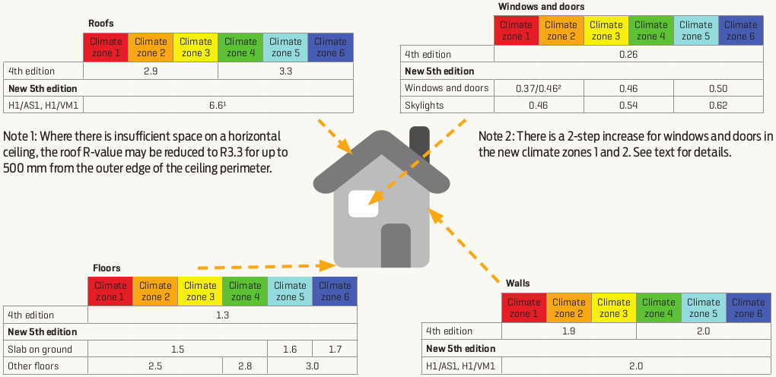
https://www.buildmagazine.org.nz/articles/show/building-code-changes-2021

Slide 6

A sustainable healthy home
Insulation levels and window R-value
Water efficiency
Regulate operational & embodied carbon
Window shading and solar performance
Regulate summertime overheating
Fixed heating in living room
A focus on outcomes
(i.e. kWh of heating)
Form factor- thermal envelope vs floor area
Window size and orientation
Designing out/reducing C&D Waste
Adequate ventilation
Indoor environment quality
Preparing for Building for Climate Change
Air-tightness
Avoidance of thermal bridges reducing condensation
Accessibility and inclusivity
Site ecology

Slide 7
A
General Provisions
A1 Classified Uses
A2 Interpretation
B
Stability
B1 Structure
B2 Durability
C Protection from Fire
C1 Objectives of C2-C6
C2 Prevention from Fire Occurring
A3 Building Importance Levels
D
Access
E
Moisture
F
Safety of Users
G Services and Facilities
H
Energy Efficiency
G1 Personal Hygiene
G2 Laundering
G3 Food Preparation
G4 Ventilation
G5 Interior Environment
G7 Natural Light
G8 Artificial Light
G9 Electricity
G10 Piped Services
G11 Gas as an Energy Source
G12 Water Supplies
G13 Foul Water
G14 Industrial Liquid Waste
G15 Solid Waste
H1 Energy Efficiency
C3 Fire Affecting Areas Beyond the Source
C4 Movement to a Place of Safety
C5 Access and Safety for Firefighting Operations
C6 Structural Stability
D1 Access Routes
D2 Mechanical Installations for Access
E1 Surface Water
E2 External Moisture
E3 Internal Moisture
F1 Hazardous Agents on Site
F2 Hazardous Building Materials
F3 Hazardous Substances and Processes
F4 Safety from Falling
F5 Construction and Demolition Hazards
F6 Visibility in Escape Routes
F7 Warning Systems
F8 Signs
F9 Restricting Access to Residential Pools
G6 Airborne and Impact Sound
Notes:
Overlap of NZ Building Code and Homestar
Grey = Homestar credits extend some criteria in the code
White = Homestar credits addressing areas not covered by the code

Slide 8
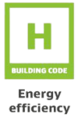
BPI
< 1.55
Notes:
New Zealand Building Code clause H1 - Energy efficiency (4th edition, amendment 3, 1 January 2017) states that: "Buildings must be constructed to ensure that their building performance index does not exceed 1.55." (H1.3.2E). Because the BPI is divided by a climate severity factor (degree months) it is largely independent of climate. The BPI applies only to houses.
The Verification Method H1/VM1 states that ALF calculates the BPI for detached dwellings. ALF’s thermal performance calculations can be used to demonstrate that a house design complies with H1, and is another method to the schedule and calculation methods in NZS 4218:2009 Thermal insulation – Housing and small buildings.
H1 explains the BPI calculation as: "The heating energy of the building divided by the product of the heating degrees total (the minimum of 12 and the degree months to a base of 14°C) and the sum of the floor area and the total wall area."
The BPI requirement in its complete form is: 1.55 kWh/(m².°C.month).

Slide 9
kWh/m²

Slide 10
kWh/m²/yr

Slide 11
Performance
Heating
Ventilation
Insulation

Slide 12
Performance
Heating
Ventilation
Insulation

Slide 13
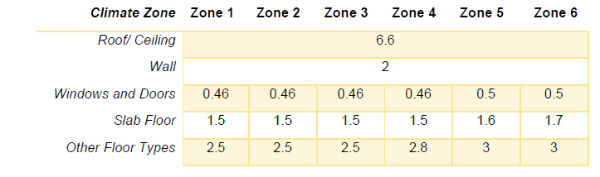

Schedule Method
H1/AS1 5th Ed.
Or…

Slide 14
Verification Method
H1/VM1 5th Ed.

Slide 15
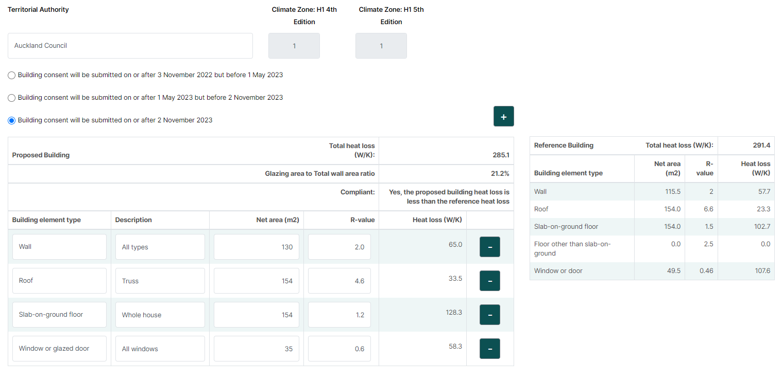
FREE
nzgbc.h1calculator.org.nz/
Do you need R 6.6?

Slide 16
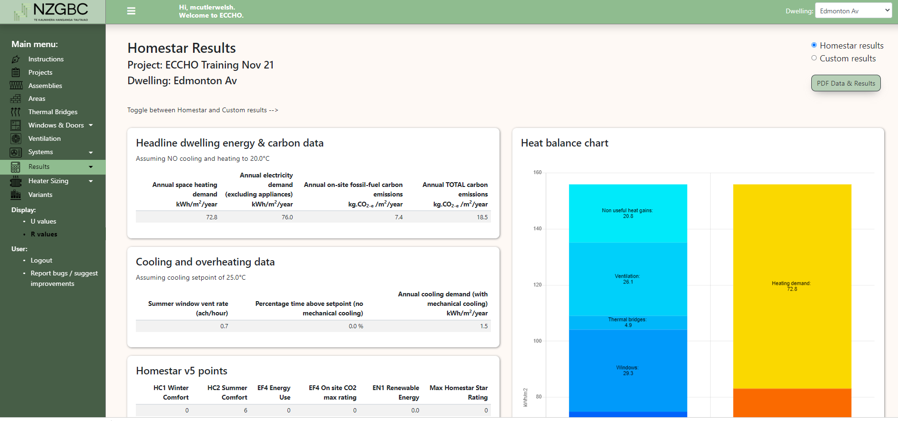

Slide 17
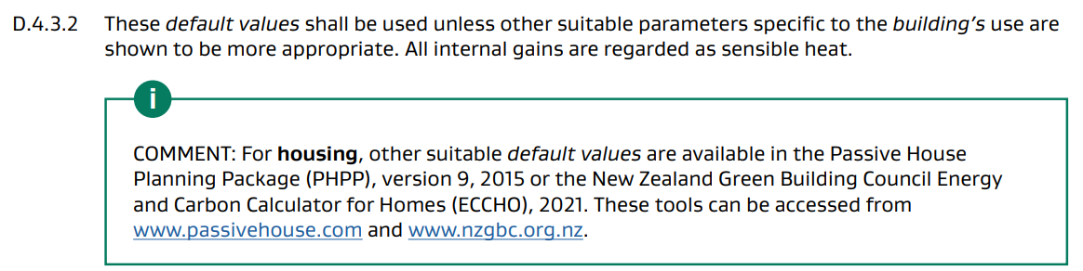
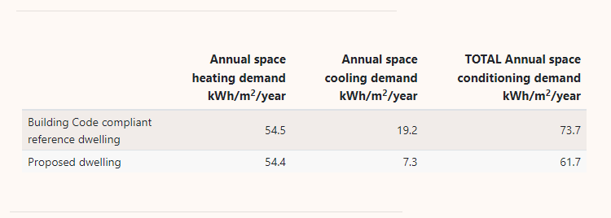
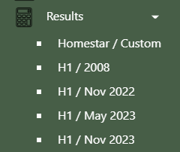
H1/VM1 5th Ed.

Slide 18

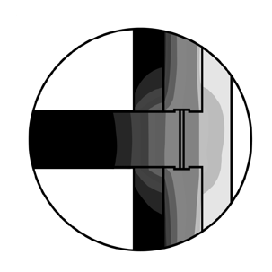

Air
Homestar v5
Bridges
Carbon

Slide 19
Air
Homestar v5

Slide 20
0.35
Notes:
G4
1.5 Mechanical ventilation
1.5.1 Mechanical ventilation systems must satisfy the following conditions: a) outdoor air supply shall be designed and equipment installed to comply with NZS 4303, or AS 1668.2 (excluding Table A1 and Sections 3 and 7), and to provide outdoor air to occupied spaces at the flow rates given in NZS 4303 Table 2,

Slide 21
NZS 4303:1990 Table 2
0.35 ACH
7.5 L/s

Slide 22
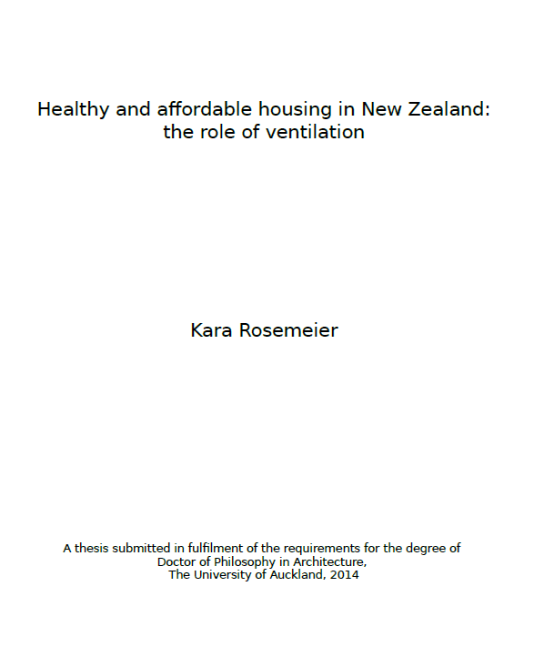
“The minimum required for ventilation – operable windows to the size of 5% the floor area – is no guarantee for effective ventilation or healthy indoor conditions.”
“It is fallacious to suggest that any amount of infiltration can substitute purposeful ventilation.”
https://researchspace.auckland.ac.nz/handle/2292/21764
Notes:
The minimum required for ventilation – operable windows to the size of 5% the floor area – is no guarantee for effective ventilation or healthy indoor conditions.
It is fallacious to suggest that any amount of infiltration can substitute purposeful ventilation.

Slide 23
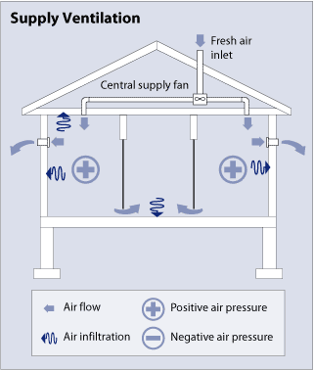
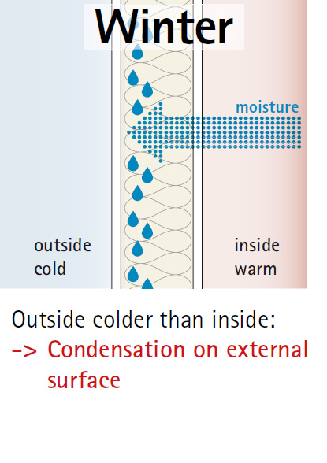


Slide 24
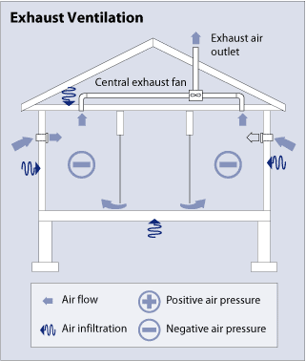


Slide 25
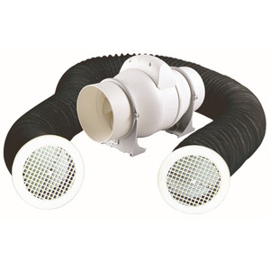

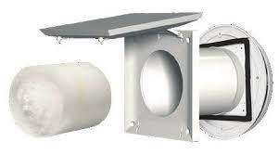

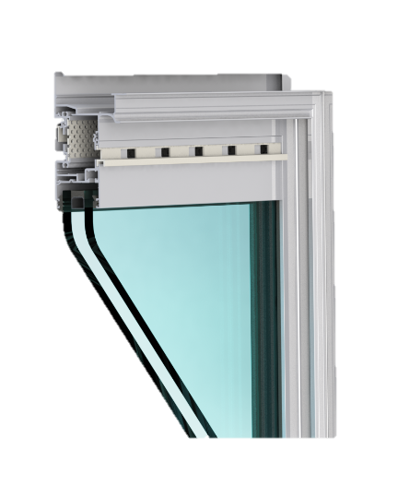
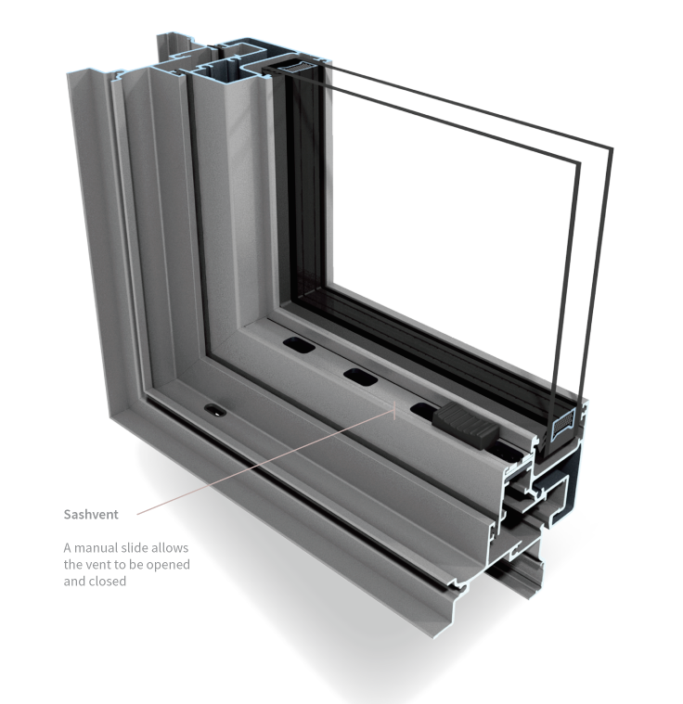
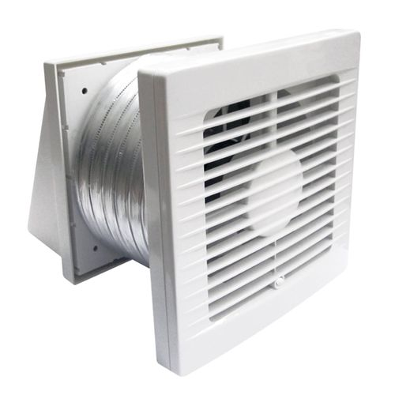

Slide 26
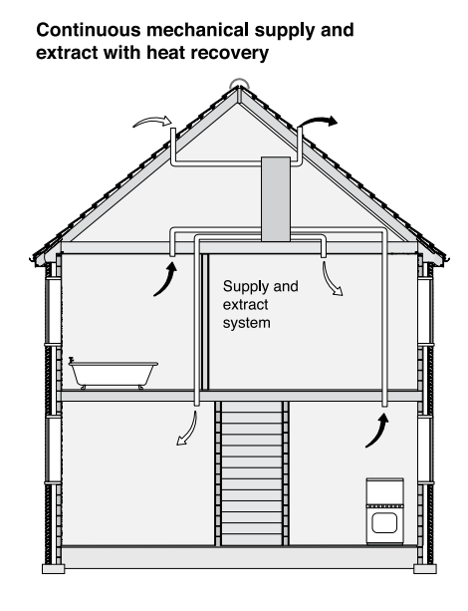
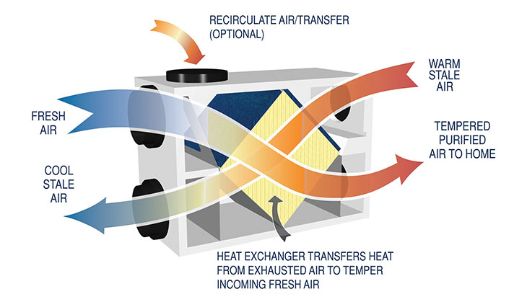
Ventilation - Balanced
Notes:
<Describe the differences between a continuous extract system and MVHR>

Slide 27
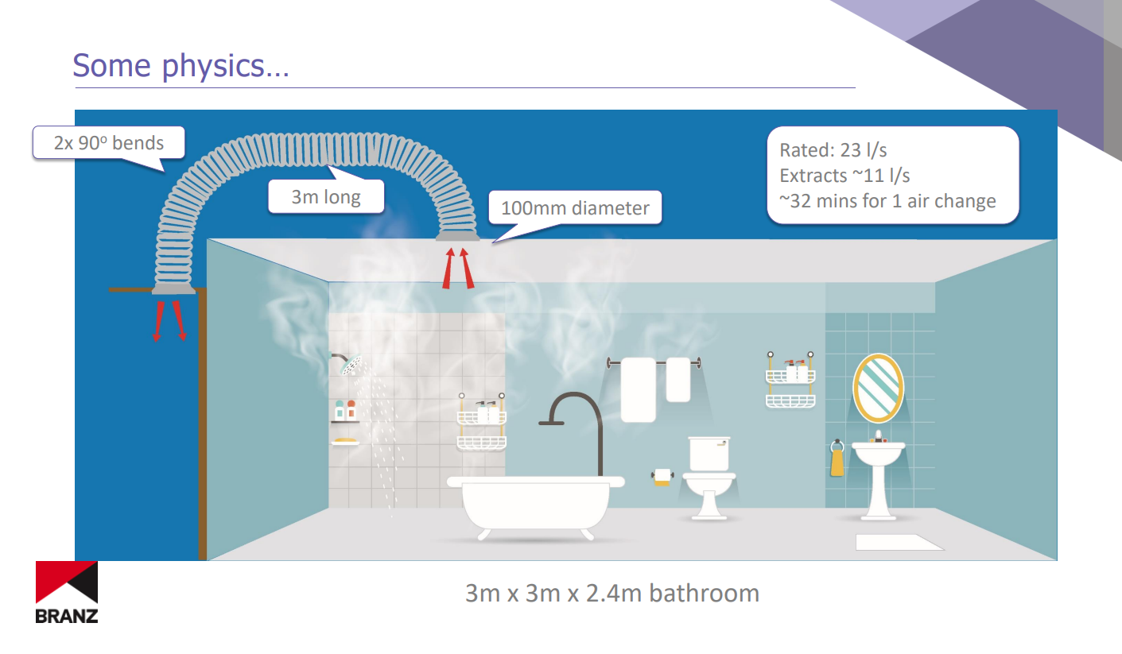
https://www.ecodesignadvisor.org.nz/wp-content/uploads/2019/11/14-VickiWhite.pdf
Notes:
https://www.ecodesignadvisor.org.nz/wp-content/uploads/2019/11/14-VickiWhite.pdf

Slide 28
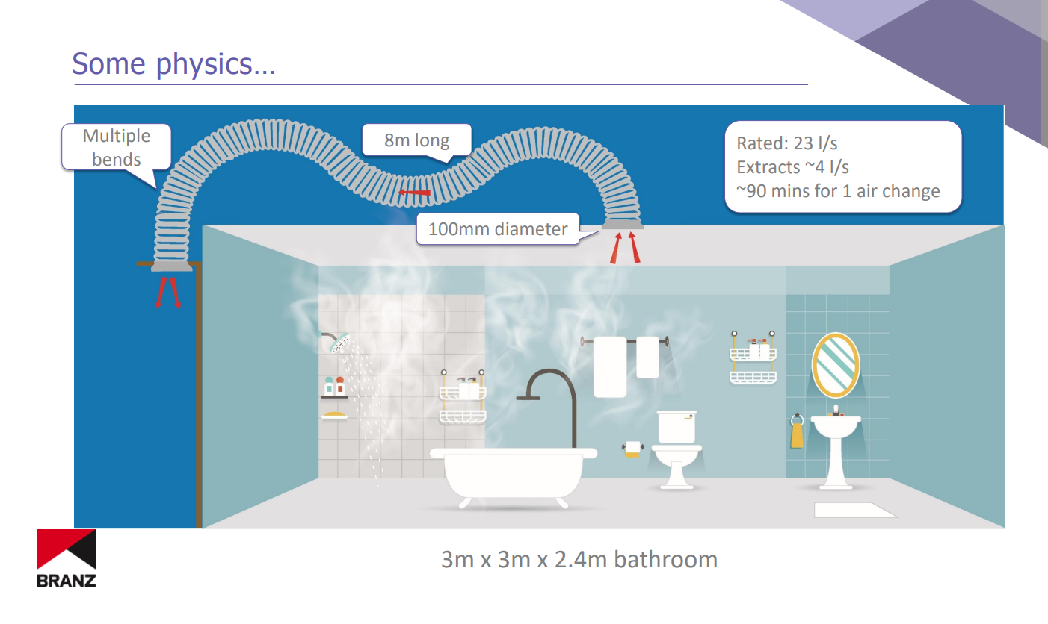

Slide 29
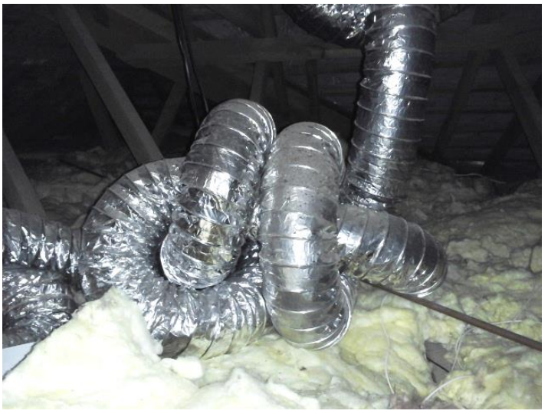
Vicki White, BRANZ

Slide 30
Homestar v5
Bridges

Slide 31
Notes:
Homestar is needed because the Building Code is deficient.
These pictures are from a house built in Auckland, completed in late 2021.
What is causing the mould growth on this window frame?
Thermal bridge (non-thermally broken frames)
Inadequate ventilation
Unhealthy indoor surface temperature

Slide 32
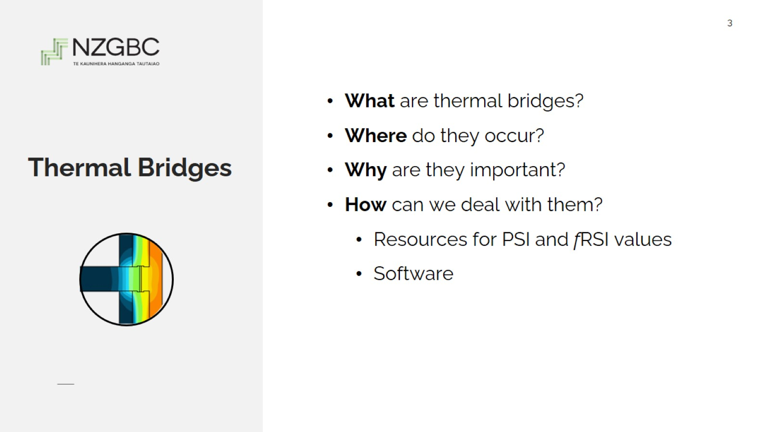
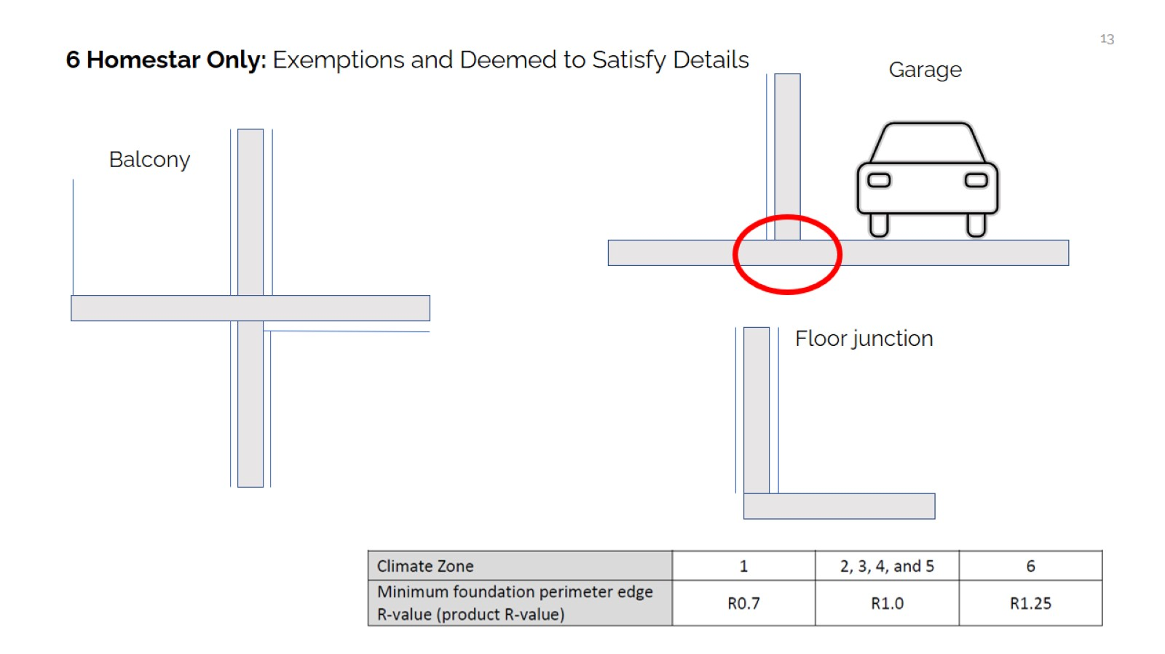

Slide 33
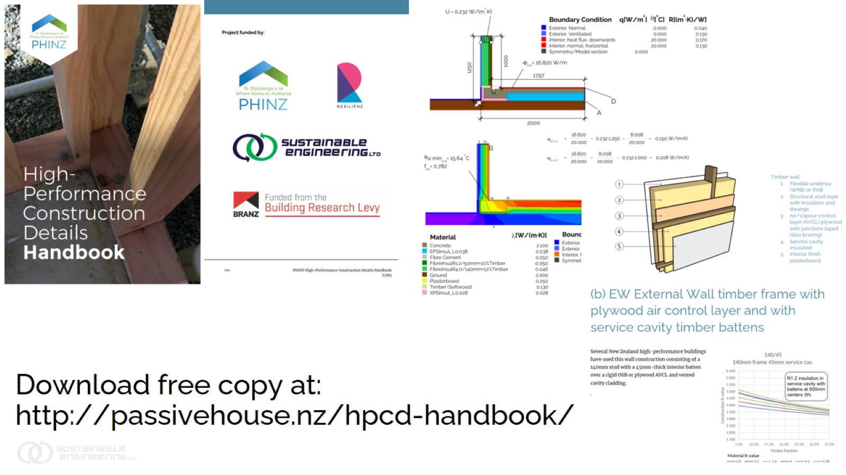
Download free copy at: http://passivehouse.nz/hpcd-handbook/

Slide 34
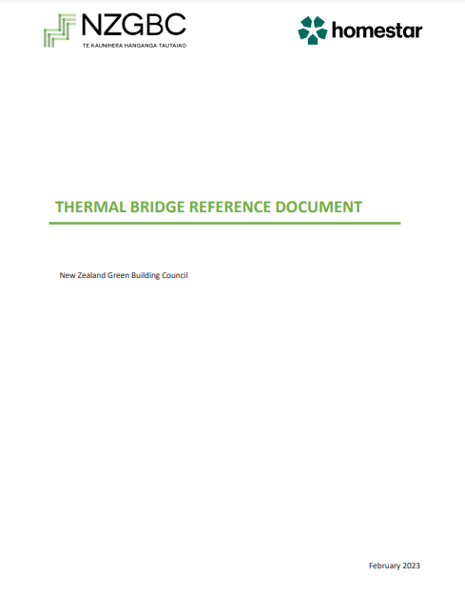
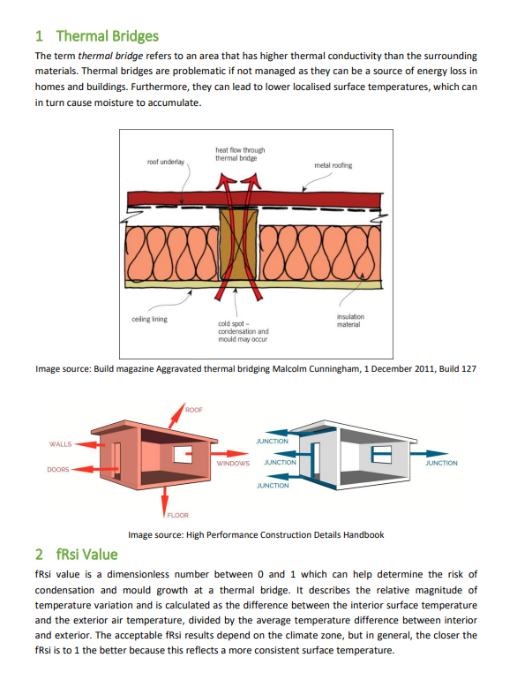

Slide 35
Homestar v5
Carbon

Slide 36
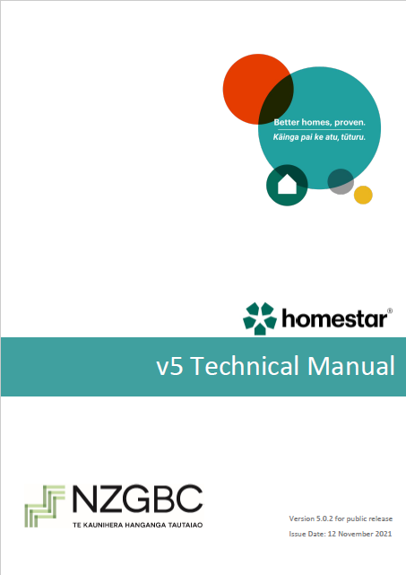
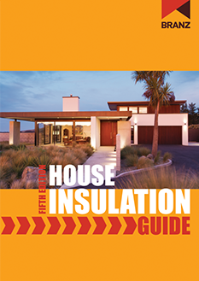
EN2: Embodied Carbon
Notes:
The embodied carbon assessment must include all the following components and assemblies:
External walls
Internal walls
Windows
Roofs
Mid-floors
Ground floor
Floor coverings
On-site electricity generation
All bulk materials that make up the assemblies must be included in the assessment. This includes final finishes such as paint but excludes minor componentry such fixings, brackets and screws that would not normally be quantified in a Bill of Quantities and/or BIM model.

Slide 37
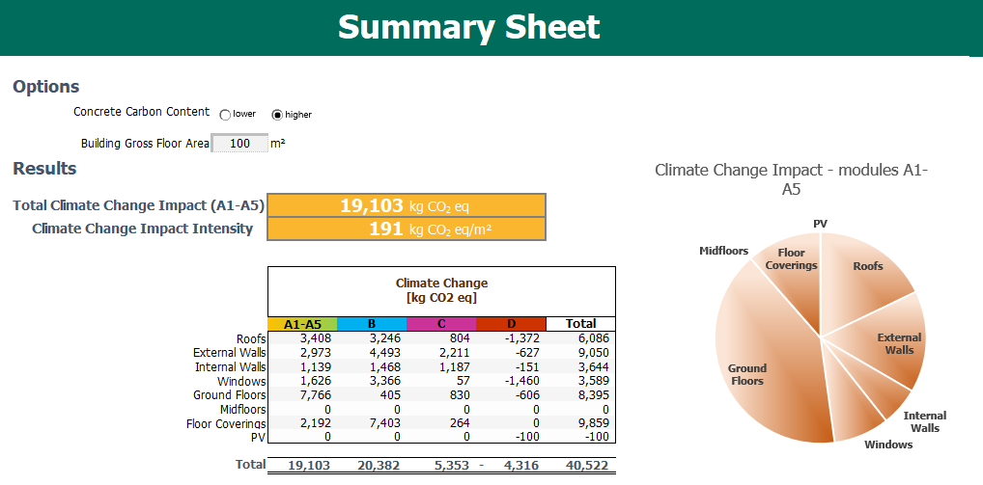

Slide 38
Air
Homestar v5
Bridges
Carbon

Slide 39

Minor improvements above H1 5th edition
Thermally broken frames and slab edge insulation
Continuous extract ventilation
Homestar reduces overheating
Notes:
For almost all specifications except the 4 Bed case in Queenstown only minor additional improvement above H1 compliance is needed to achieve 6 Homestar levels in overall energy, heating demand, and overheating potential - where the design required thermally broken glazing and slab edge insulation to meet H1. Where the H1 compliance didn’t require either thermally broken glazing or edge insulation, the mandatory addition of both on the Homestar specification allows insulation in other elements to potentially be reduced.
In almost all locations for both designs, the heating load was higher than H1 reference building, however H1 (Fifth Edition) compliance was achieved by reduced overheating.

Slide 40
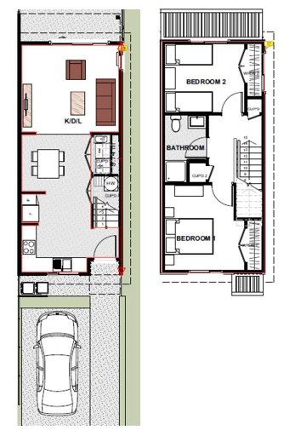
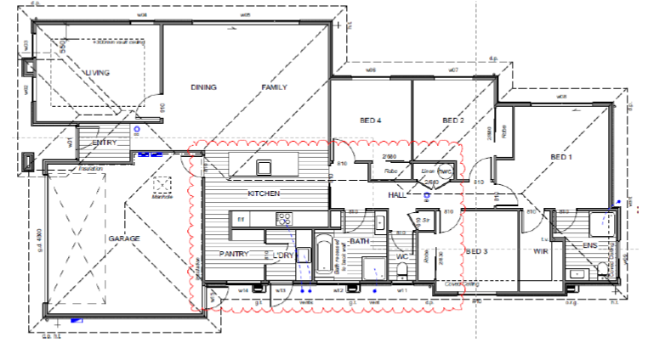


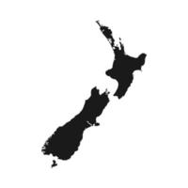
H1 → 6 HS v5
0% - 1.3%

Slide 41

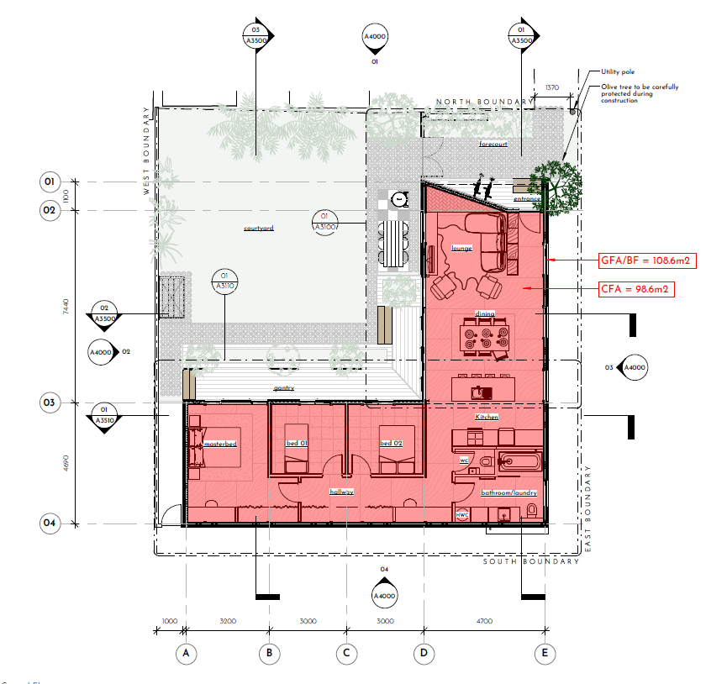
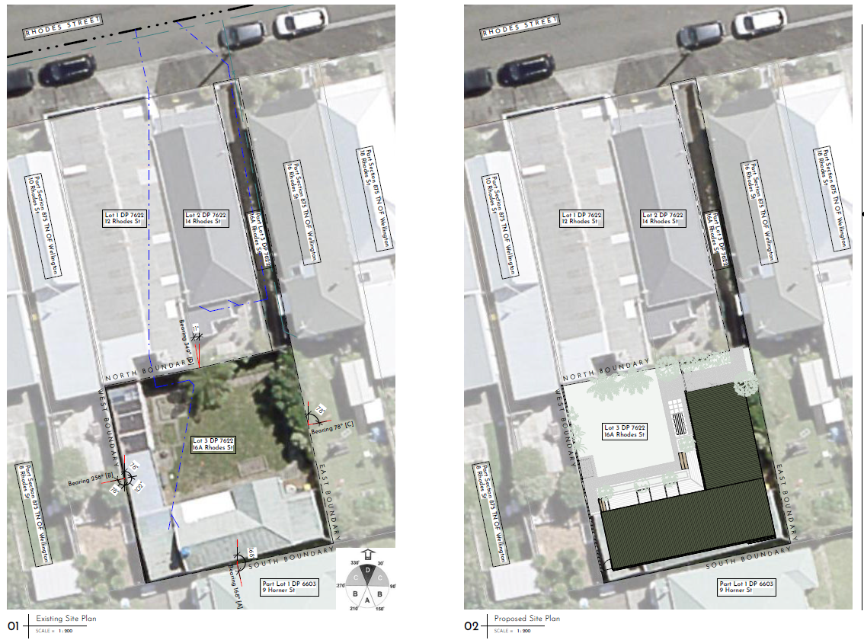
Wellington: Targeting 7 Homestar v5
Assessor & Architect: Sam Brown
100 m²
3 bedrooms
Notes:
"The Restricted Section (16a Rhodes Street) is a new build in central Wellington that employs clever design, prefabrication and quality construction to provide a stunning new family home for a young professional couple and their young daughter.
The old dilapidated house is being demolished to make way for a new SIP home that uses the panels systems for the floors, walls and roof. This construction methodology is a first for the client, contractor and architect and we are all excited by the opportunity it presents."

Slide 42
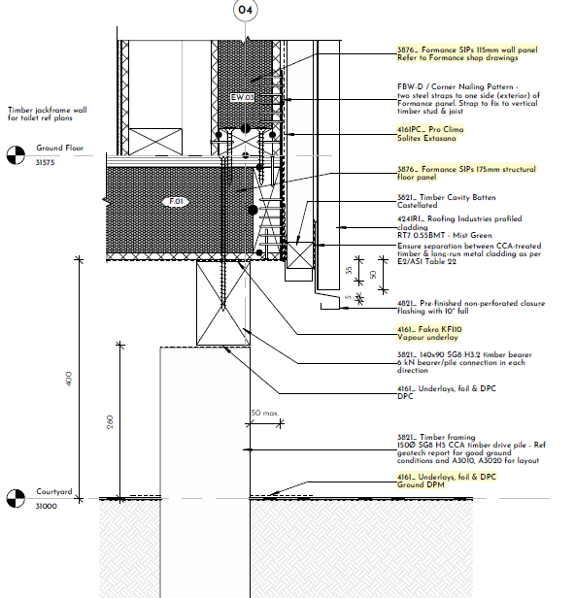
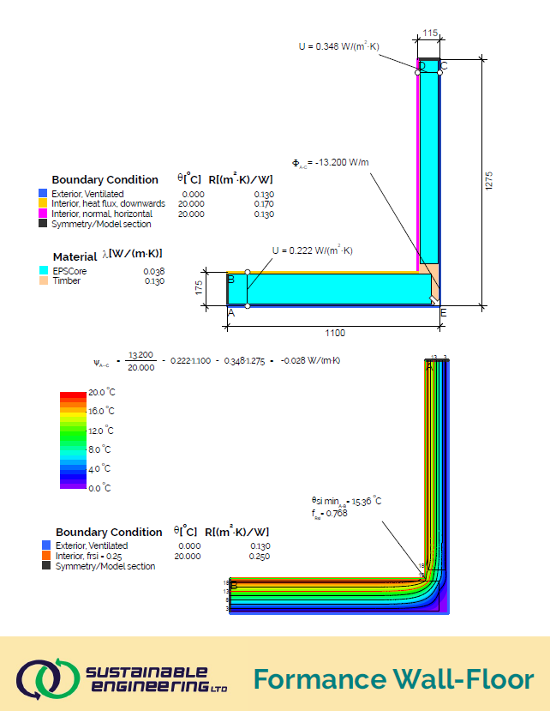
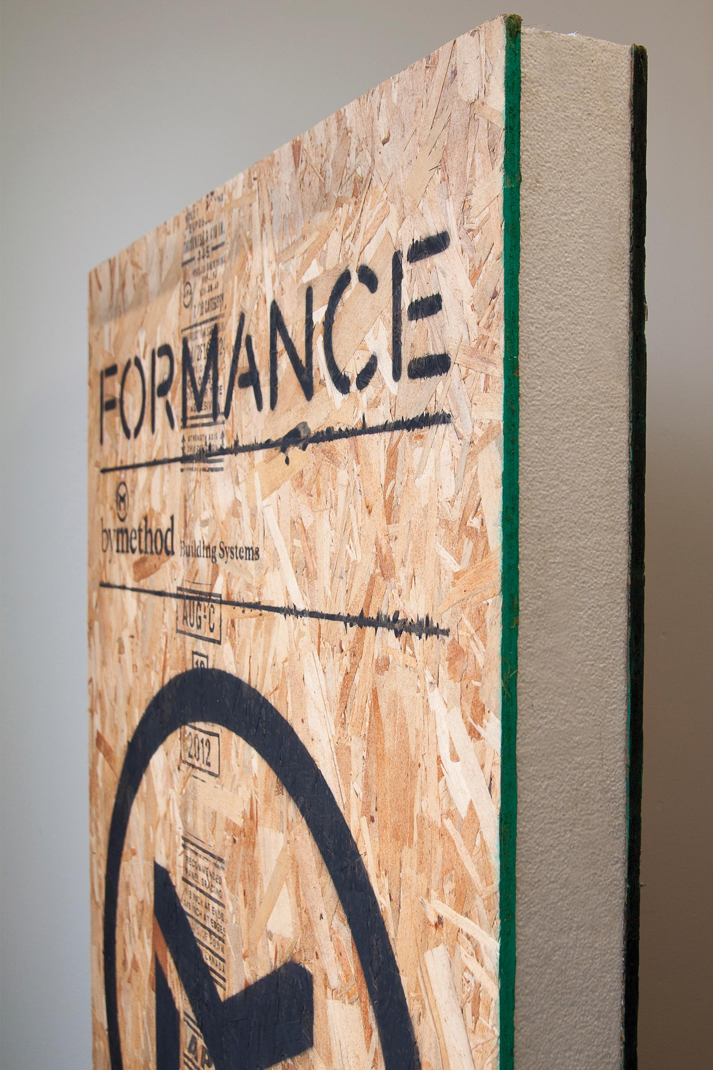

Slide 43
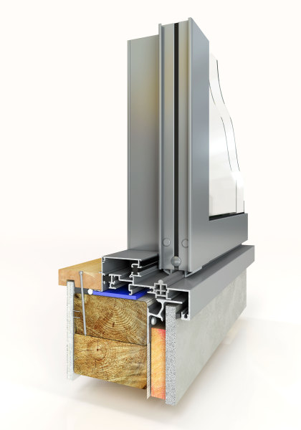
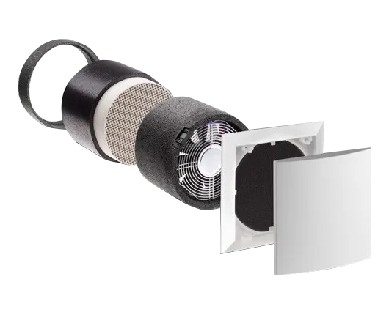
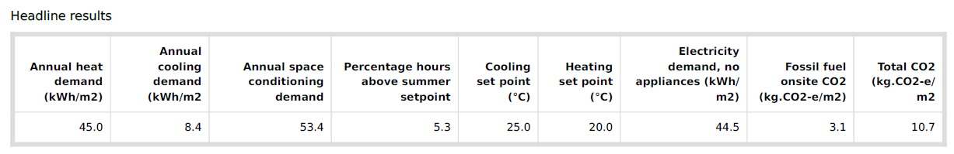
1 – 2 ACH: Approximately 5x more airtight than average
Altus thermally broken window frames, double glazing with argon
Lunos decentralised heat recovery ventilation

Slide 44


“Kāinga Ora values the partnership we have with the New Zealand Green Building Council in delivering homes that go beyond many current building code requirements to help improve our customers’ quality of life.
Building all of our new homes to at least the 6 Homestar standard is an important step towards improving the health, social and financial benefits for our customers, as well as being an important tool to help us meet our carbon emissions and waste-reduction aspirations.
Where possible, we see it as our responsibility to lead better building and sustainability practices in New Zealand. The support we receive from the NZGBC and the relationship we have formed has helped us continue to make strides in this area. We look forward to continuing to work with them.”
Andrew McKenzie, Kāinga Ora Chief Executive

Slide 45
Uptake
3,512
2023

Slide 46











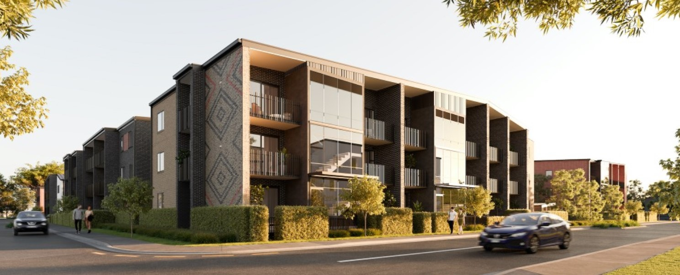





Others building to Homestar

Slide 47


1.5% lower rates for green verified homes
Notes:
Westpac and ASB offer home loans (HomeFit)

Slide 48
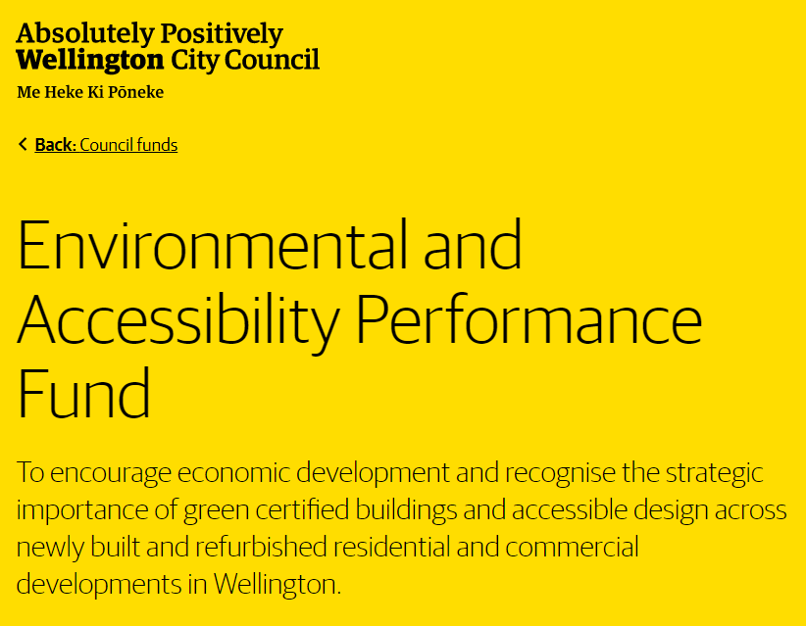
$20m
Notes:
Must be a multi-unit residential development of 10 or more units.
No new natural gas connections.
Achieve minimum points in Homestar across the ‘Reducing Construction Waste Criteria’ for Minimising, Onsite Sorting, and Waste Diversion categories.
Achieve relevant accreditation from Homestar or Living Building Challenge. Certification must be the current version when a building consent is submitted and must be valid within the last six months of final application.

Slide 49
A
General Provisions
A1 Classified Uses
A2 Interpretation
B
Stability
B1 Structure
B2 Durability
C Protection from Fire
C1 Objectives of C2-C6
C2 Prevention from Fire Occurring
A3 Building Importance Levels
D
Access
E
Moisture
F
Safety of Users
G Services and Facilities
H
Energy Efficiency
G1 Personal Hygiene
G2 Laundering
G3 Food Preparation
G4 Ventilation
G5 Interior Environment
G7 Natural Light
G8 Artificial Light
G9 Electricity
G10 Piped Services
G11 Gas as an Energy Source
G12 Water Supplies
G13 Foul Water
G14 Industrial Liquid Waste
G15 Solid Waste
H1 Energy Efficiency
C3 Fire Affecting Areas Beyond the Source
C4 Movement to a Place of Safety
C5 Access and Safety for Firefighting Operations
C6 Structural Stability
D1 Access Routes
D2 Mechanical Installations for Access
E1 Surface Water
E2 External Moisture
E3 Internal Moisture
F1 Hazardous Agents on Site
F2 Hazardous Building Materials
F3 Hazardous Substances and Processes
F4 Safety from Falling
F5 Construction and Demolition Hazards
F6 Visibility in Escape Routes
F7 Warning Systems
F8 Signs
F9 Restricting Access to Residential Pools
G6 Airborne and Impact Sound
Notes:
Overlap of NZ Building Code and Homestar
Grey = Homestar credits extend some criteria in the code
White = Homestar credits addressing areas not covered by the code

Slide 50
A
General Provisions
A1 Classified Uses
A2 Interpretation
B
Stability
B1 Structure
B2 Durability
C Protection from Fire
C1 Objectives of C2-C6
C2 Prevention from Fire Occurring
A3 Building Importance Levels
D
Access
E
Moisture
F
Safety of Users
G Services and Facilities
H
Energy Efficiency
G1 Personal Hygiene
G2 Laundering
G3 Food Preparation
G4 Ventilation
G5 Interior Environment
G7 Natural Light
G8 Artificial Light
G9 Electricity
G10 Piped Services
G11 Gas as an Energy Source
G12 Water Supplies
G13 Foul Water
G14 Industrial Liquid Waste
G15 Solid Waste
H1 Energy Efficiency
C3 Fire Affecting Areas Beyond the Source
C4 Movement to a Place of Safety
C5 Access and Safety for Firefighting Operations
C6 Structural Stability
D1 Access Routes
D2 Mechanical Installations for Access
E1 Surface Water
E2 External Moisture
E3 Internal Moisture
F1 Hazardous Agents on Site
F2 Hazardous Building Materials
F3 Hazardous Substances and Processes
F4 Safety from Falling
F5 Construction and Demolition Hazards
F6 Visibility in Escape Routes
F7 Warning Systems
F8 Signs
F9 Restricting Access to Residential Pools
EF1: Resource Efficiency
EF2: Urban Density
EF4: Water Use
G6 Airborne and Impact Sound
HC2: Summer Comfort
LV1: Inclusive Design
LV2: Occupant Amenities
LV3: Eco-Friendly Living
LV4: Sustainable Transport
EN1: Renewable Energy
EN2: Embodied Carbon
EN4: Construction Waste
EN5: Site Water and Ecology
EN6: Responsible Contracting
Notes:
Overlap of NZ Building Code and Homestar
Grey = Homestar credits extend some criteria in the code
White = Homestar credits addressing areas not covered by the code

Slide 51





WHAT THIS MEANS
Homestar v5 &
Building for Climate Change
Operational Emissions Cap | Initial cap | Int. cap | Final cap
Electricity use (kWh/m²/yr) | 180 | 90 | 45
Heating/cooling demand (kWh/m²/yr) | 60 | 30 | 15
Fossil fuel emissions (CO₂-e/m²/yr) | 18 | 9 | 0
Water (L/p/day) | 145 | 110 | 75
Homestar v5 alignment
Notes:
For H1 updates I’m only showing roof values to illustrate.

Slide 52

nzgbc.org.nz/eventshub

